Slide 1
The CMS Phased Return to In-person Instruction Plan
Charlotte-Mecklenburg Board of Education
September 16, 2020
Notes:
Matt

Slide 2
Objectives
Share a return to face-to-face instruction plan
The plan will include a timeline for a phased in return of both teachers and students
Staff will share how metrics informed the development of the plan
We will ask the Board of Education to approve the plan and authorize the ability to implement furloughs
Notes:
Earnest

Slide 3
Local Context
Governor declared K–12 public schools in NC will open in Plan B
CMS Board voted to begin the school year in Plan C, with the understanding that staff would, in parallel, develop a viable plan to transition to Plan B
CMS Board voted July 30 to begin bringing our exceptional students back to school for in-person learning. Identified students will begin transitioning to in-person learning as early as September 29.
Plan | Public Health Scenario | Back to School Scenario
Plan A | State COVID-19 metrics continue to stabilize and/or move in a positive direction. | Minimal social distancing required. All students attend school, at the same time and in-person daily.
Plan B | State COVID-19 metrics worsen and it is determined additional restrictions are necessary. | Moderate social distancing required. School facilities and vehicles limited to no greater than 50% maximum capacity.
Plan C | Only if state COVID-19 metrics worsen significantly enough to require suspension of in-person instruction and implementation of remote learning plans required by Session Law 2020-3. | Remote learning only. No students utilize district facilities or transportation.
Notes:
Matt

Slide 4
Guiding Principles
The safety of our students and school-based faculty/staff is of utmost importance
Children benefit most from in-person learning and the association socialization which accompanies it
Data (e.g., state and local public health metrics, operational effectiveness, etc.) will inform the timing and rapidity with which CMS transitions to Plan B
The transition to Plan B will be staggered by grade level(s) (i.e., CMS will not transition all grade levels, PreK – 12, to Plan B simultaneously)
Attendance groups A, B and C will remain intact (i.e., CMS will not reduce the number of attendance groups)
Decisions will be made districtwide (i.e., CMS will not transition schools in one part of the district at a different cadence than schools in another part of the district)
Notes:
Matt

Slide 5
Stakeholder Engagement
Principal Leadership Advisory Team (PLAT)
Superintendent’s Teacher Advisory Council (STAC)
Teacher Design Session (teachers identified and selected by principals and central office instructional leaders)
Generation Nation (student feedback sought on remote learning)
Focus group with cross section of families and parent-facing organizations (e.g., YMCA, Charlotte Bilingual Preschool, West Side Education Think Tank, etc.)
Mecklenburg County PTA Council - two breakout sessions during September 12 conference
Notes:
Matt

Slide 6
Data-Informed Plan
Notes:
Matt

Slide 7
Data-Informed, Phased-In Approach
Phase one: Bright Beginnings and NC Pre-K
Subsequent phases will bring students back by grade level over time
Some amount of time is needed between phases:
Given A, B, C attendance designations, it will take three weeks for each student in a given grade level to experience in-person instruction
Time needed to assess the stability of public health and operational metrics
Time needed to adjust processes (e.g., symptom screening) for future phases based on what we learn in current phase
Students in the Full Remote Academy will continue with remote instruction full-time
Notes:
Matt

Slide 8
Model
Week | 1 | 2 | 3 | 4 | 5 | 6 | 7 | 8 | 9 | 10 | 11 | 12
PreK | PreK students (excluding Montessori PreK)
K |  |  |  | A | B | C | A | B | C | A | B | C
1 |  |  |  | A | B | C | A | B | C | A | B | C
2 |  |  |  | A | B | C | A | B | C | A | B | C
3 |  |  |  | A | B | C | A | B | C | A | B | C
4 |  |  |  | A | B | C | A | B | C | A | B | C
5 |  |  |  | A | B | C | A | B | C | A | B | C
6 |  |  |  |  |  |  | A | B | C | A | B | C
7 |  |  |  |  |  |  | A | B | C | A | B | C
8 |  |  |  |  |  |  | A | B | C | A | B | C
9 |  |  |  |  |  |  |  |  |  | A | B | C
10 |  |  |  |  |  |  |  |  |  | A | B | C
11 |  |  |  |  |  |  |  |  |  | A | B | C
12 |  |  |  |  |  |  |  |  |  | A | B | C
Phase 1 - PreK A, B, C groups do not apply; excludes Montessori PreK Phase 2 - Montessori PreK, K – 5 Phase 3 - 6 – 8 Phase 4 - 9 - 12
Best case scenario, with all public health and operational effectiveness metrics remaining stable, it will take 12 weeks, from the beginning of phase 1, to complete the phased transition to Plan B.
Notes:
Matt

Slide 9
Supplemental Care for Students
After School Enrichment Program (ASEP)
Before- and after-school programs will operate at as many of the existing 96 licensed sites as demand and staffing availability allow
Registration will begin at the onset of phase 1 and programming will begin at the onset of phase 2
Before- and after-school programs will be prioritized for students during their in-person learning weeks and be available for students learning remotely as space allows
Notes:
Brian

Slide 10
Metrics; Health and Safety for In-person Learning
Notes:
Matt

Slide 11
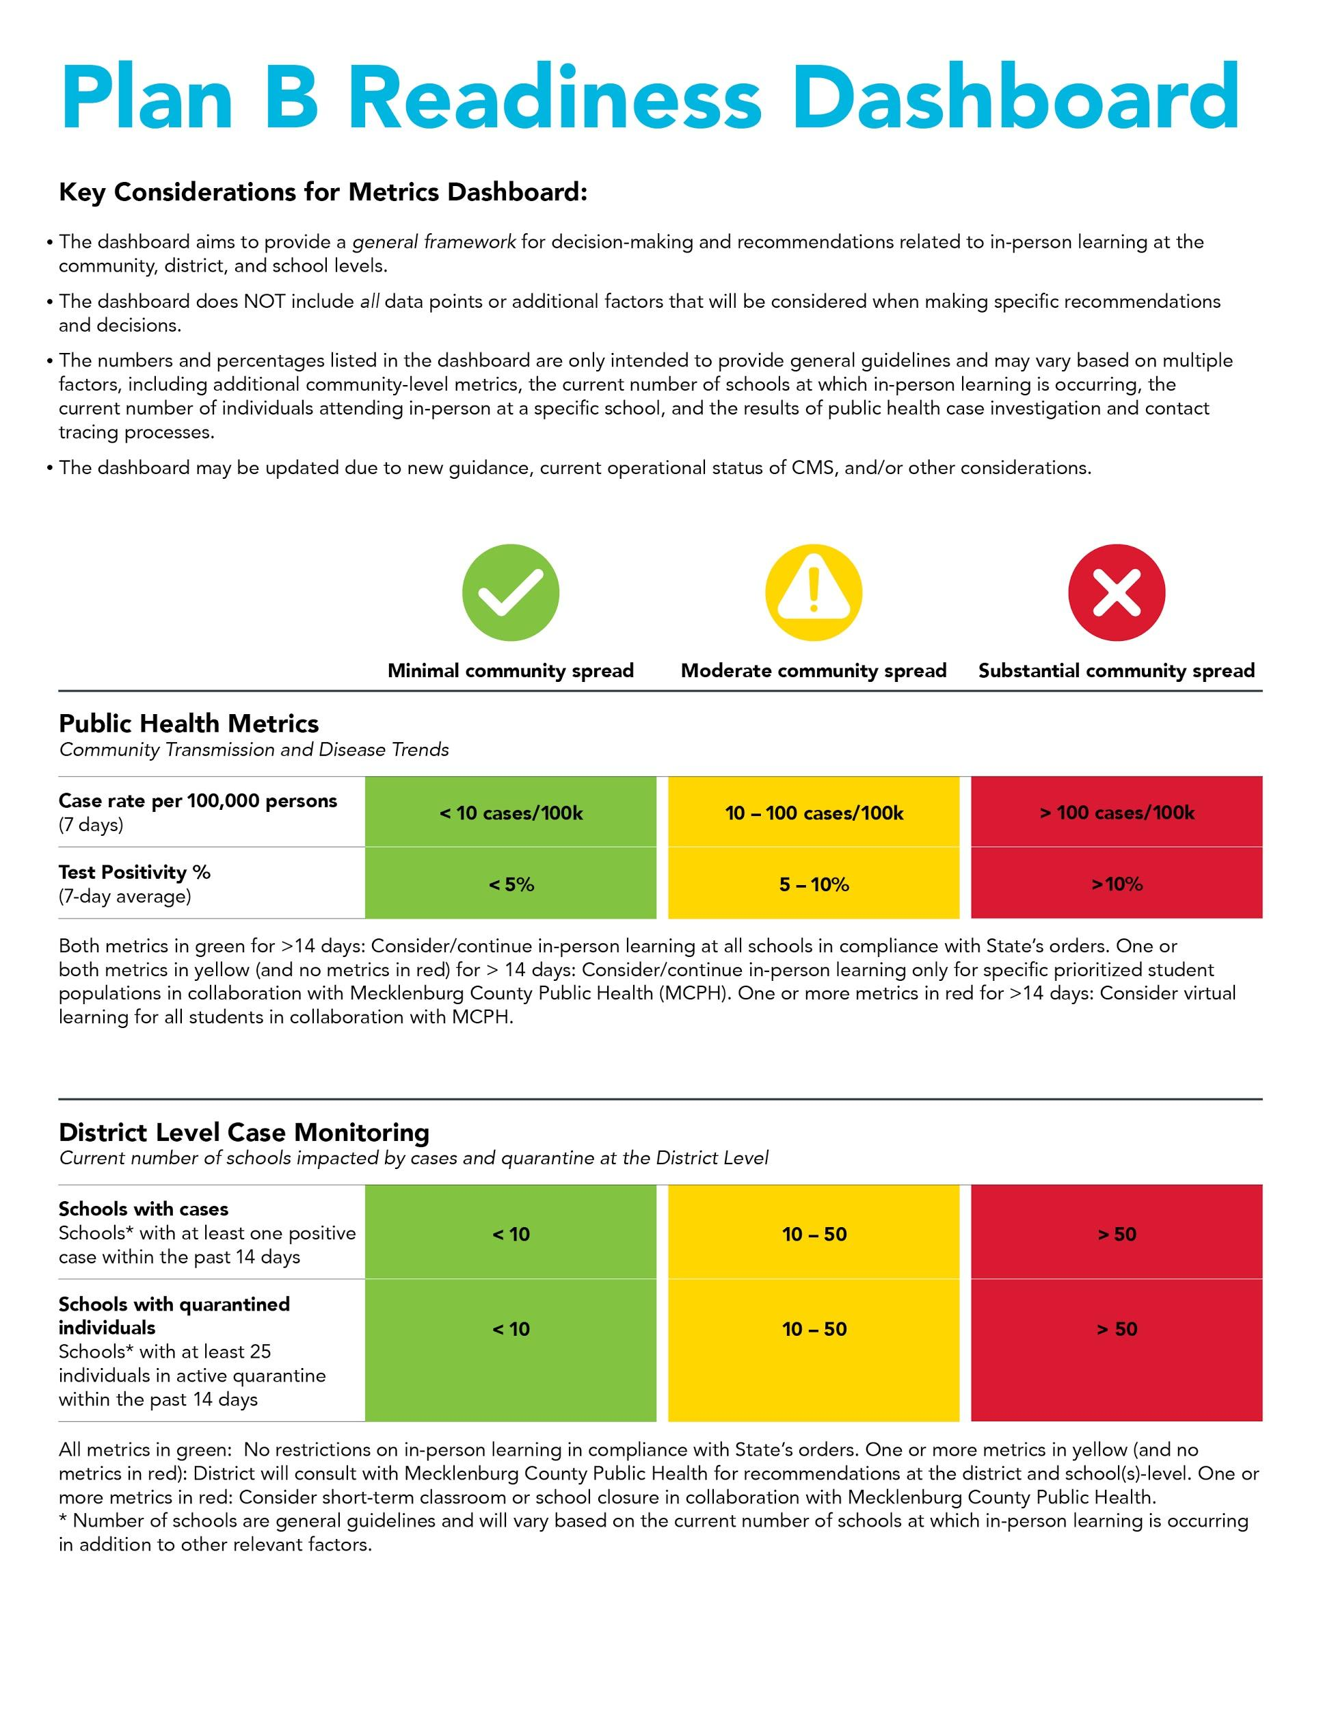
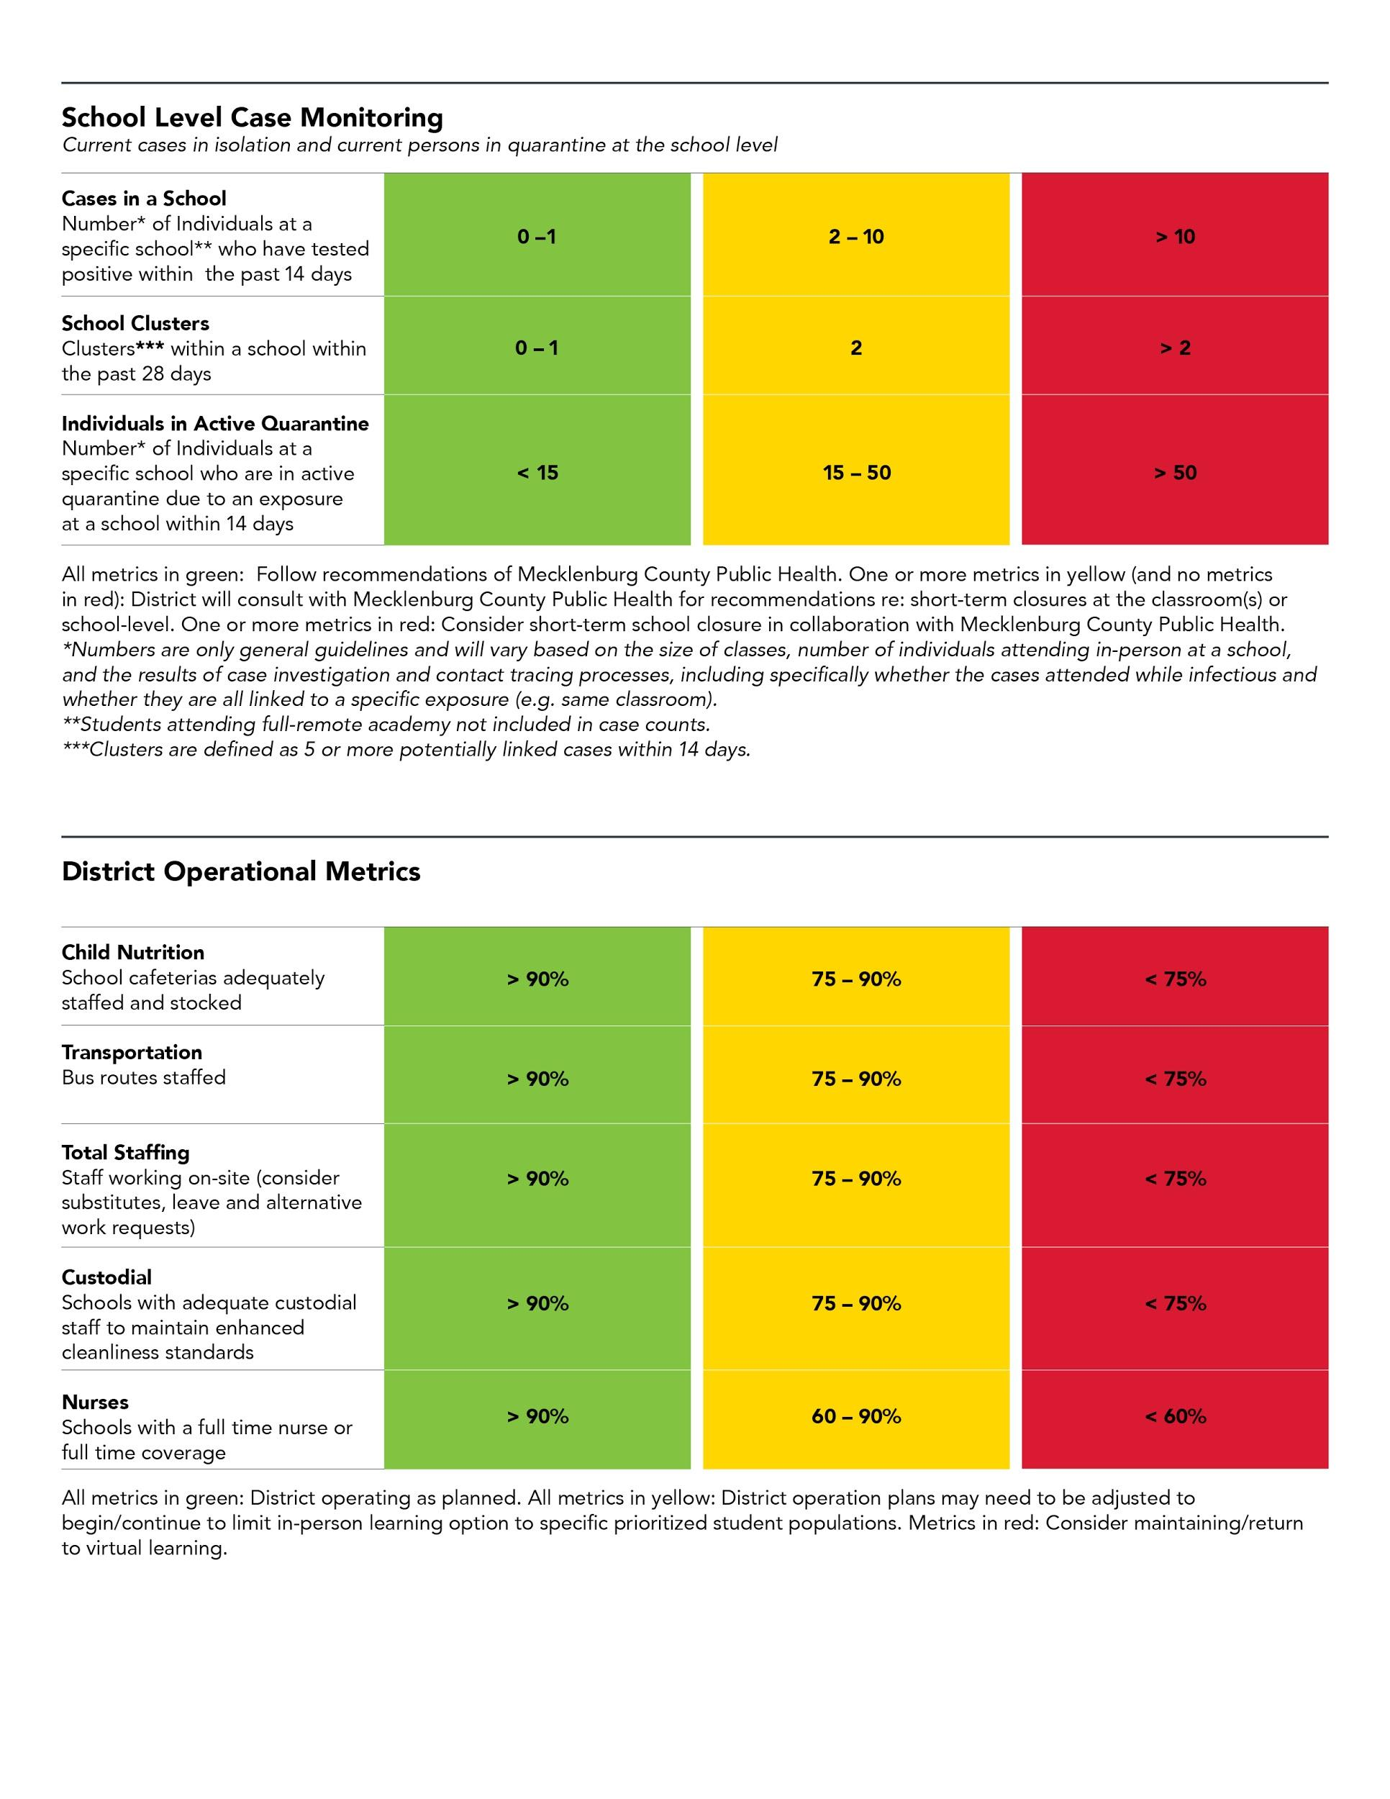
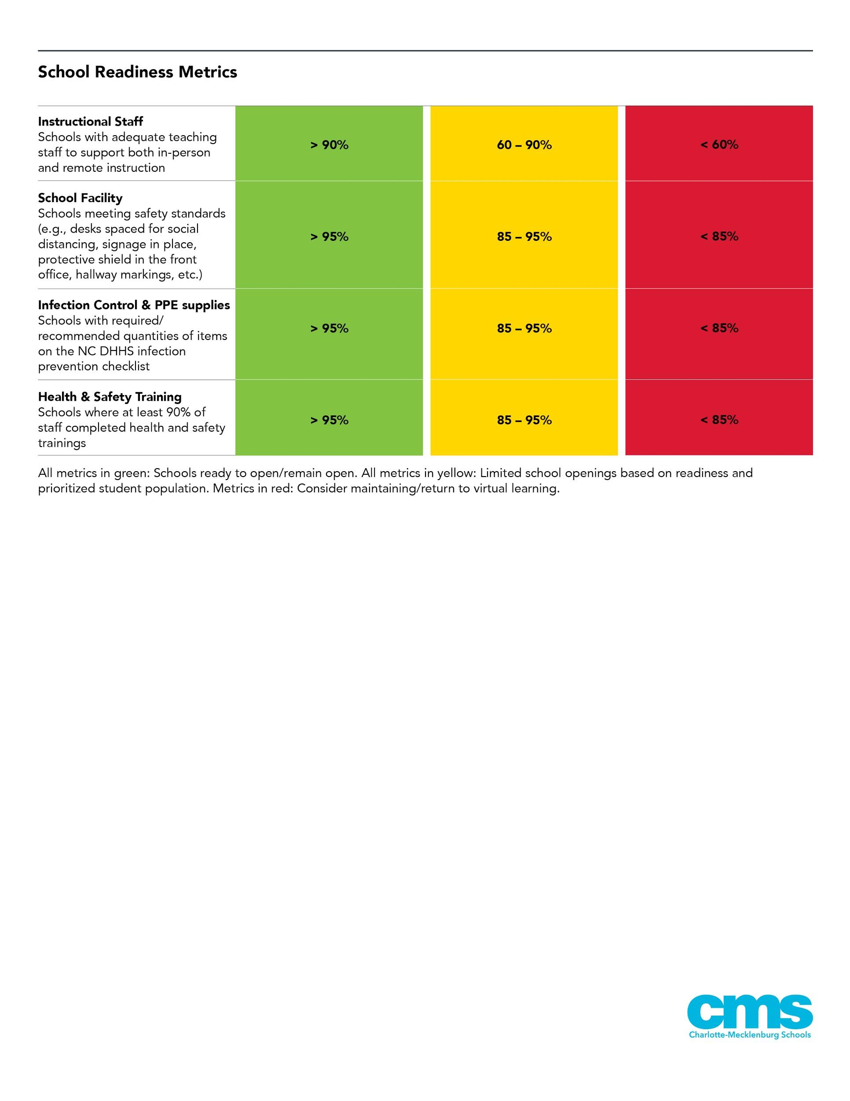
Dashboard
Notes:
Kathy
Question from Elyse:1) Do we expect the school-by-school audit to be ready by 9/16?- no we are continuing to conduct audits, prioritizing schools that are in the first phase
2) Will the school-by-school dashboard be ready by 9/16? No- the school-by school metrics (staffing primarily) will need to be fleshed out as a result of the approved plan

Slide 12
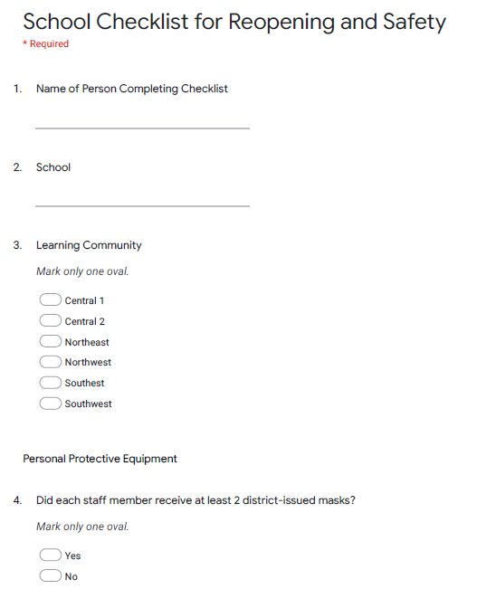
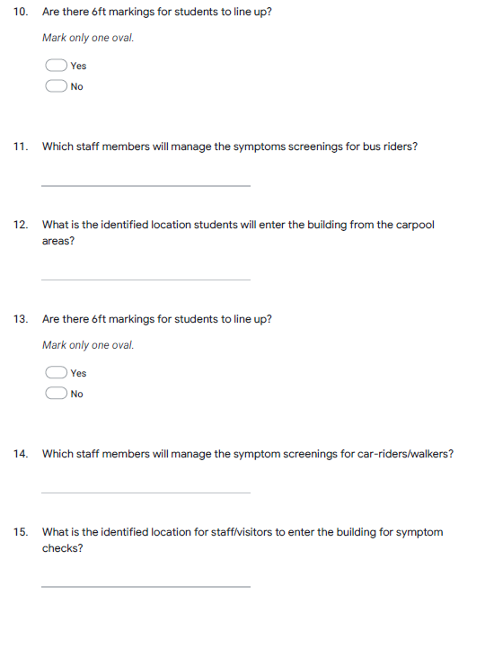
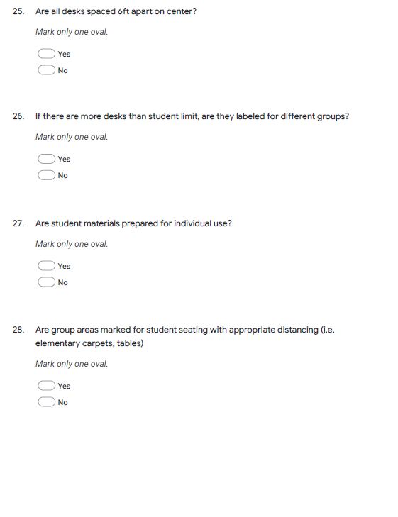
School Readiness and Safety Audits
School readiness audits will be performed at all CMS schools.
Learning community superintendents will work with school leadership to evaluate readiness across many elements, including Personal Protective Equipment (PPE), classroom set-up, scheduling, as well as plans to execute key procedures such as arrival/screening and handling suspected cases.
Notes:
Kathy
Question from Elyse:1) Do we expect the school-by-school audit to be ready by 9/16?- no we are continuing to conduct audits, prioritizing schools that are in the first phase
2) Will the school-by-school dashboard be ready by 9/16? No- the school-by school metrics (staffing primarily) will need to be fleshed out as a result of the approved plan

Slide 13
Health & Safety During In-Person Learning
Symptom screening
Cohorting students to minimize transitions and equipment sharing
Student schedules reflect additional time for social distanced breaks to include restroom, hand-washing
Addressing student illness
Isolation room procedures
Notes:
Kathy

Slide 14
Operations and Facilities Readiness
Notes:
Matt

Slide 15
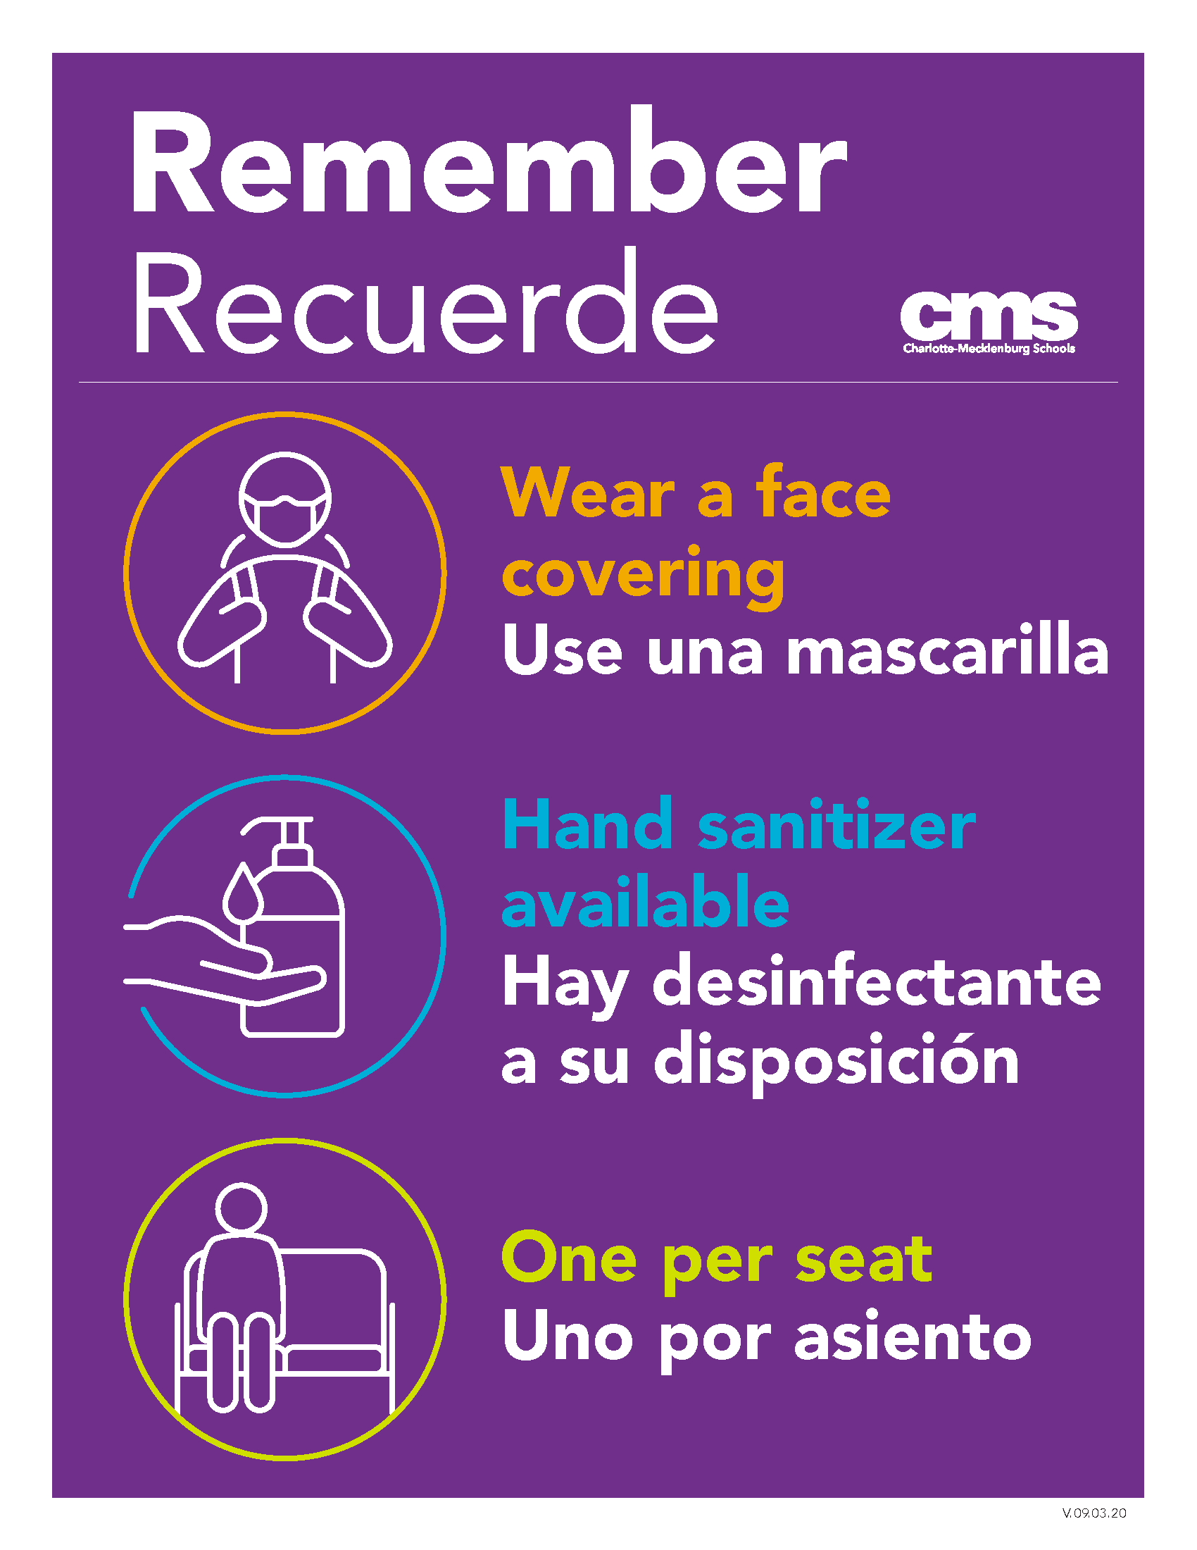
Transportation
All students who are in the A, B, C rotations have been assigned to buses
Transportation will begin on the first day of face-to-face instruction for any phase; Exceptional Children transportation to begin September 29
Maximum 24 per bus (one child per seat)
Attestation process for students before boarding bus
High school end bell time adjusted
Notes:
Carol’s rep/Laura
Attestation forms provided weekly on students’ first day of rotation or Mondays for EC/Pre-K.
Transportation will not leave children unattended at stops if they are there on wrong rotation or without forms. Will transport and notify school staff upon arrival.

Slide 16
CMS Eats @ Home
How the program will change once we’re in phase 2 of transition to B
September 29: Charlotte-Mecklenburg Academy, Metro School, all Specialized Behavior Support (SBS), Extensions and EC Pre-K return to school daily in up to 80 schools; CMS Eats @ Home continues weekly meal bundle delivery and pick up at 40 school sites
Phase 1 - date TBD: all Pre-K return to school daily; CMS Eats @ Home continues weekly meal bundle delivery and pick up
Phase 2 - date TBD (planned for three weeks after Phase 1): K-5 return to school in A, B and C weekly rotations; CMS Eats @ Home transitions to weekly meal bundle pick up only from this point forward; buses and available drivers fully involved in transporting students. Some adjustments to pick up sites will be made, including possibly increasing number of open pick-up sites
Students in school daily and/or on their weekly rotation will receive breakfast and lunch in school and will not receive meal bundles for that time or week
Notes:
Carol’s rep/Laura

Slide 17
Health and Safety Infection Control & PPE*
NCDHHS** Requirements/Recommendations
Provided for Staff & Students | Provided for Facilities | In Process of being Provided
Face coverings (staff and students) | Hand Soap | Face shield – 1 per school-based staff
Hand sanitizer (individual bottle for staff and supervised use for students) | Hand sanitizer dispensers and stands (various areas of buildings) | Additional hand sanitizer (1 gallon container) and 2 hand sanitizer stations for isolation rooms
Multipurpose alcohol-based wipes | Acrylic barriers for main office | Sanitizing/disinfectant spray bottles for teacher/staff cleaning of classes/equipment as needed
Emergency Personal Protective Equipment (PPE) for nurses and designated staff (for medical purposes) | COVID related signage and floor markers | Booster pack of emergency PPE from the state (additional face shields and surgical masks)
Disposable cups for drinking from water fountains | Signage above water coolers to restrict drinking directly from fountain | Water bottles for each student
Digital thermal thermometers | Electrostatic disinfectant sprayers and disinfectant product for specialized cleaning | Several desk style acrylic barriers for shared use in schools
*Cleaning Products Will be Reordered and Restocked
**North Carolina Department of Health and Human Service
Notes:
Carol’s rep/laura

Slide 18
Health and Safety – $3.7M+ Invested
Supplies ordered and on hand include, but are not limited to:
66,000 - bottles of hand sanitizer (various sizes)
10,500 - gallons of hand soap
1,300,000 - pairs of gloves
155,000 - various face coverings / shields for staff
48,000 - face coverings for Exceptional Children and K-2 students (youth size)
35,000 - alcohol wipes and disinfectant spray product
Notes:
Carol’s rep/laura

Slide 19
Health and Safety – Facilities
Air Flow / Circulation
HVAC (heating, ventilation and air conditioning) system operation schedules have been adjusted to provide conditioned air for longer durations with the intent to balance temperature and humidity levels while operating fans for longer periods of time.
All exhaust fans were verified for proper operation to ensure continuous air flow movement in hallways and restroom areas.
Optimize HVAC systems’ air flow by thoroughly cleaning all air side components in order to restore operational parameters as close as is possible to the original designed air flow; ongoing since 2015
Completed air optimization projects at 50 schools (22 are in schools without outside air)
Remaining 17 schools without outside air scheduled for completion in 2020-2021
Notes:
Carol’s rep/laura

Slide 20
Health and Safety – Facilities (cont.)
Filtration / Air Filters
Upgrade from current MERV-8 filters to MERV-10 filters
Schools with no or partial outside air (completion by mid-October)
Other schools by end of December 2020
Engaging three engineering consultants to evaluate and recommend any additional cost-effective and relevant solutions for mitigating the issue of airborne aerosol transmission of viruses
Ventilation / Outside Air Introduction
Increase fresh outside conditioned air introduction to the buildings by 10-15% where possible (must balance temperature and humidity)
For sites with no mechanical outside air capability, windows and/or interior doors may be opened to improve air flow from hallways and exterior areas
Continuing to research and consider other strategies/technologies to improve air quality and movement of air
Notes:
Carol’s rep/laura
ANNOUNCE A BREAK HERE

Slide 21
Student Learning Experiences During Plan B
Notes:
Matt

Slide 22
Full Remote Academy Expectations
Participation will continue throughout the first semester and families will have an opportunity to re-evaluate their FRA decisions for the second semester
Requests for transfer in and out of the Full Remote Academy should be submitted in writing via email, fax or hand-written letter to the assigned school’s registrar before Friday, December 4, 2020.
Requests to transfer between Plan C (or the district’s current attendance plan) and the FRA prior to the second semester should be handled at the school level.
Notes:
Brian

Slide 23
Full Remote Academy Expectations (cont.)
Requests should be approved if the school can reasonably accommodate the request without major disruptions to the master schedule and the request meets at least one of the criteria below:
A member of the household, including but not limited to the student, received a new medical diagnosis which puts them in a high risk category
A sudden change in access to childcare
A sudden change in the family’s finances or employment
A change in school assignment due to a move or approved transfer
Notes:
Brian

Slide 24
Student Experience During Plan B
Instruction
Direct access to teachers for daily instruction
Opportunities for interventions/enrichment
Small-group instruction should align to grade-level standards
Exceptional Children, English Language Learner (ELL), Talent Development service time/accommodations will be met for students during remote and in-person instruction
Teachers will provide opportunities for and encourage student collaboration/discourse during synchronous instruction
All students will engage in a social emotional learning (SEL)/advisory block
Co-curricular Opportunities
All schools, to the best extent possible, will begin offering co-curricular activities including before- and after-school clubs remotely to their students
Examples: Math Olympiad, Speech and Debate, etc.
Notes:
Brian

Slide 25
Student Experience During Plan B (cont.)
Screen Time
Students will be allowed to use print materials to reduce screen time and/or meet student needs.
Synchronous/asynchronous instruction will be in alignment with district guidelines.
Teachers should balance the amount of work and time students spend on asynchronous work (online or print materials), whether during the allotted class time, or time spent on homework and independent projects.
Students should be provided with the opportunity to engage in asynchronous learning on their own/during their own time frames.
Time on camera for monitoring students as they work independently should be minimized, except when student supervision takes priority, such as when administering formal assessments.
Notes:
Brian

Slide 26
Student Experience During Plan B (cont.)
Meaningful feedback
Meaningful feedback will be provided to students and based on learning goals for content mastery
Teachers will provide due dates for graded assignments that allow reasonable flexibility for completion
Social distancing
In-person student activities will remain socially distanced during instruction, lunch, class changes, arrival and dismissal, and appropriate symptoms screenings will be done to ensure safety
Class sizes: Adhere to K–3 guidelines and NCDHHS guidance for socially distancing, in-person students
Notes:
Brian

Slide 27
Staffing and
Supplemental Support
Notes:
Matt

Slide 28
Child of Staff Full-Day Programming
Daily onsite option for children of school-based staff and bus drivers
All K–8 children of school-based staff and bus drivers are eligible; children must be enrolled in CMS
K-8 students may attend their assigned school or the school at which their parent / guardian works
If choosing the school at which the parent / guardian works, the grade span of the parent / guardian’s school must include the student’s grade of enrollment
Full-day option offered during the student’s two-week remote learning period
Students will participate in their remote learning, supervised by school staff
Students will not participate in in-person learning with their teachers during this time
Supervision will be provided during the normal bell schedule by school-based staff as assigned by the principal. Before- and after-school care is not provided and must be determined separately.
Notes:
Christine

Slide 29
Staff Expectations
Select Exceptional Children staff serving students in the following programs will return to work onsite beginning September 28: Metro School, Charlotte-Mecklenburg Academy, Extensions Program, Specialized Behavior Support (SBS) Program, Homebound and EC Pre-K Separate.
All other teachers will report to their school buildings two weeks before their students return.
Exceptions
Teachers assigned to the Full Remote Academy may continue to work remotely during the 2020-2021 school year, depending on their caseload and the needs of their assigned students.
School-based employees who have received approval from Human Resources to work remotely will be permitted to continue in a remote capacity through December 31, 2020, if their duties can be done remotely.
Notes:
Christine

Slide 30
Overview of COVID-Related Leaves
Families First Coronavirus Response Act (FFCRA) and Paid Sick Leave Act
All employees
Up to 80 hours of paid sick leave (either full or ⅔ pay)
Up to 10 additional weeks of leave for childcare related reasons (⅔ pay)
Diagnosed, quarantined, or caring for someone with COVID
CMS Local Emergency Leave
Non-exempt employees only
Up to 80 hours of paid leave
Loss of work, childcare, diagnosed, quarantined, or caring for someone with COVID
Notes:
Christine

Slide 31
Furloughs
What is a furlough? Temporary leave of absence (vs. layoff) allowing CMS to maintain the employment relationship with its valued employees who are temporarily without work due to remote instruction
Potential impact? Approximately 140 employees at risk of full furlough; approximately 1,225 partial furlough
Furlough vs. layoff?
Furlough status:
Maintains the employment relationship
Provides employees the opportunity to make immediate changes to benefits due to temporary financial hardship
Allows employees to file for unemployment due to reduction of hours
Potential date? Only if necessary and not earlier than September 21
Notes:
Christine

Slide 32
Recommendation
Authorize the transition to Plan B, beginning with Phase 1
Pre-K teachers required to report to school buildings daily, no sooner than Monday, September 28
Pre-K students to return for in-person learning two weeks after the return of Pre-K teachers and no sooner than Monday, October 12.
Subsequent phases will be implemented with a minimum of three weeks between the beginning of each phase.
Decisions regarding the implementation of subsequent phases will be informed by the dashboard, and both the public health and operational readiness indicated therein.
Authorize the ability to implement furloughs
Notes:
Earnest

Slide 33
Recommendation
Week | Sept. 29 | Oct. 5 | Oct. 12 | Oct. 19 | Oct. 26 | Nov. 2 | Nov. 9 | Nov. 16 | Nov. 23 | Nov. 30 | Dec. 7 | Dec. 14 | Dec. 21, 28 | Jan. 5 | Jan. 11 | Jan. 18
PreK | Teachers Return |  | PreK students (excluding Montessori PreK)
K |  |  |  | Teachers Return |  | A | B | C | A | B | C | A |  | B | C | A
1 |  |  |  | Teachers Return |  | A | B | C | A | B | C | A |  | B | C | A
2 |  |  |  | Teachers Return |  | A | B | C | A | B | C | A |  | B | C | A
3 |  |  |  | Teachers Return |  | A | B | C | A | B | C | A |  | B | C | A
4 |  |  |  | Teachers Return |  | A | B | C | A | B | C | A |  | B | C | A
5 |  |  |  | Teachers Return |  | A | B | C | A | B | C | A |  | B | C | A
6 |  |  |  |  |  |  | Teachers Return |  | A | B | C | A |  | B | C | A
7 |  |  |  |  |  |  | Teachers Return |  | A | B | C | A |  | B | C | A
8 |  |  |  |  |  |  | Teachers Return |  | A | B | C | A |  | B | C | A
9 |  |  |  |  |  |  |  |  |  | Teachers Return |  | High School EOC Testing |  | B | C | A
10 |  |  |  |  |  |  |  |  |  | Teachers Return |  |  |  | B | C | A
11 |  |  |  |  |  |  |  |  |  | Teachers Return |  |  |  | B | C | A
12 |  |  |  |  |  |  |  |  |  | Teachers Return |  |  |  | B | C | A
Notes:
Matt

Slide 34
Appendix

Slide 35
School
Plan B - High School Example
HS
Master Schedule Considerations
Key questions
Typical journey
What time does Liam attend this lesson? Is he required to attend at this time?
Liam is required to attend a synchronous algebra session from 8:30-9:30 AM. If Liam has an ongoing conflict (e.g., part-time job), he can work with the school to enroll him in another section of the course. If absent on a particular day (e.g., if he is sick), he may view a recording of the lecture online to catch up on the material missed
In what activities does Liam partake during class?
For the first 30 minutes, Liam attends a large group lecture. For the second 30 minutes, Liam works in a small breakout group on an algebra problem set
Who teaches Liam’s class? Which peers are in Liam’s class?
Liam’s lecture is taught by Mr. Cohen, who teaches 4 sections of 10th grade Algebra from his home office. Liam’s peers include students throughout the district who have opted to enroll in a fully virtual option. Mr. Cohen is assisted by Mr. Bierman, who is a paraeducator. While Mr. Cohen delivers the lecture, Mr. Bierman helps manage the class and answers questions via the chat function. Both educators join students’ breakout groups as is needed to provide additional support
What rules does Liam have to follow while in class?
Liam is expected to have his web-camera on, actively participate, and behave in a non-disruptive manner. If Liam fails to comply with these rules, he will be given a warning. If the issue continues, Liam will be required to have a meeting with his teacher and guardian to develop a plan to resolve his behavior
What work is Liam expected to complete outside of class?
Liam is expected to read his textbook and complete a series of online modules that correspond to each lesson
How is Liam’s attendance taken?
To be marked present and receive credit for the learning hours associated with this course, Liam must be logged on for the duration of the synchronous session and complete all associated online modules prior the start of the following lesson. Both metrics are automatically tracked and recorded by his learning platform
Notes:
Brian/Prinicpals
Question from Elyse: 1) Hybrid teaching – ie, masked teacher will teach the students in classroom, while simultaneously teaching students on remote. Can we explain how this is going to work? I assume our neighboring districts have sorted this out? It will be good to show what the model is and that we have solved for it.

Slide 36
Athletics
Staggered Return of High School Athletic Teams to CMS Campuses
Monday, September 14, launched the start of our staggered return of high school athletic teams for skill development workouts on our campuses. No off-campus workouts are permitted at this time except for the October 12 – 31 gymnasium exception at high school voting sites. Below is the recommendation from high school athletic directors on staggered return dates for remaining teams to our campuses. September 14, 2020 (1st CMS pre-season skill development workout – previously approved.)
Cross Country – run the school campus only
Volleyball – off-campus exception October 12 – 31 only if high school is an early voting site
November 4, 2020 – 1st NCHSAA practice
September 28, 2020 Swim and Dive – dry land workouts only on school campus November 23, 2020 – 1st NCHSAA practice
September 30, 2020 Basketball - off-campus exception October 12 – 31 only if HS is an early voting site Cheerleading – no mats December 7, 2020 - 1st NCHSAA practice
October 5, 2020 Men’s Soccer Men’s & Women’s Lacrosse January 11, 2021 - 1st NCHSAA practice
Notes:
Sue, if needed

Slide 37
Athletics (cont.)
Staggered Return of High School Athletic Teams to CMS Campuses
October 12, 2020 Football Marching Band* - Under Consideration February 8, 2021 – 1st NCHSAA practice
October 19, 2020 Men’s and Women’s Golf Men’s Tennis Women’s Soccer Softball March 1, 2021 – 1st NCHSAA practice
October 26, 2020 Baseball Women’s Tennis Men’s & Women’s Track and Field Wrestling – no mats April 12, 2021 – 1st NCHSAA practice
Notes:
Sue, if needed

